Slide 1

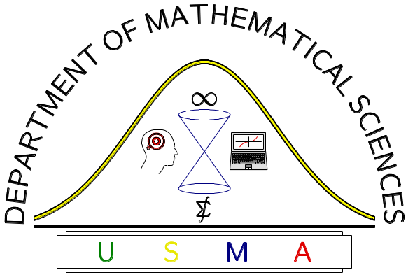
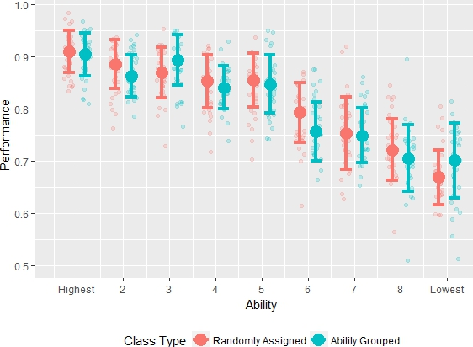
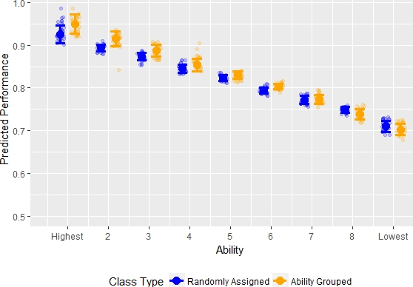

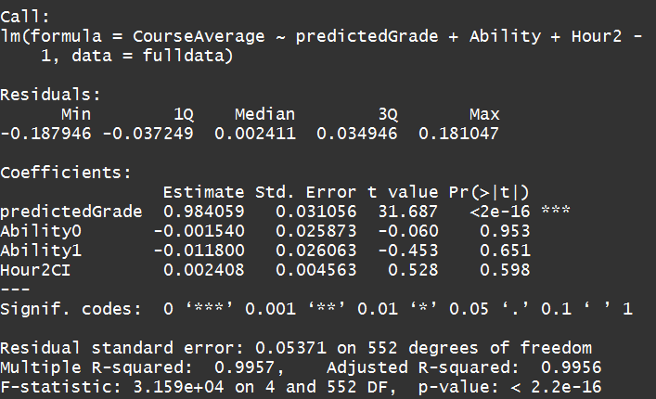
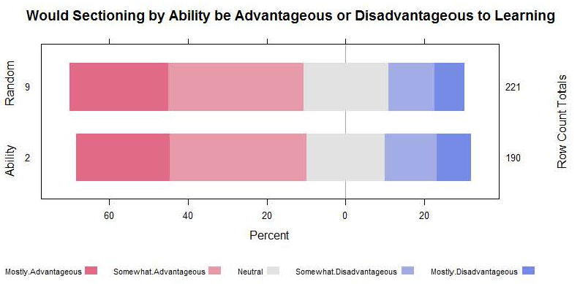
Academically Homogeneous Classrooms in Undergraduate Statistics Education
MAJ JIM PLEUSS
UNITED STATES MILITARY ACADEMY
Experiment Structure
Actual Performance of Treatment and Control Based on Ability
Predicted Performance of Treatment and Control Based on Ability
Treatment
190 Students (18 sections)
Homogenous sectioning based on past academic performance.
Control
221 Students (19 sections)
Heterogeneous mixture based on random distribution.
Metric
Compare Performance on
Course-wide Graded Events.
Significance
Survey Results
Contact Info:
Conclusions
Tried a number of different models and tests controlling for many combinations and interactions of:
Predicted Grade
Ability Level
Ability vs. Random
Class Hour
Instructor
None revealed any significance relating to Ability vs. Random Sections.
Student surveys reveal an overall positive sentiment towards sectioning by ability. However, the quantitative comparison of the two groups showed no significant difference in learning perceptions or engagement level.
There appears to be no quantitatively significant benefit to grouping statistics sections based on past academic performance.
Learning Statistics is very different from other core math courses. Predicting performance is difficult.
Students and Faculty alike believe sectioning by ability improves student learning.
Contact Info:
james.d.pleuss.mil@mail.mil
jim.pleuss@gmail.com
Work: 845-938-5609

